Slide 1
The NB Economy
VIRTUAL CONFERENCE
Herb Emery, Vaughan Chair in Regional Economics, Program Chair, JDI Roundtable on Manufacturing Competitiveness in New Brunswick, UNB

Slide 3
The Premier’s growth target 2% per year

Slide 4
Exports drive the NB economy

Slide 5
What makes up our GDP?

Slide 6
How do we earn a living?

Slide 7
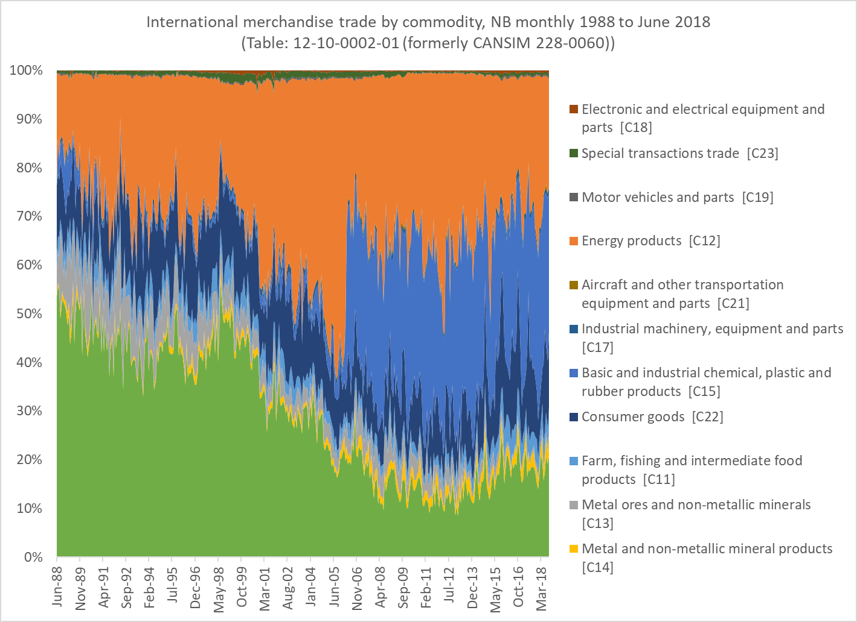
What do we export?

Slide 8
New Brunswick is consuming and not producing like it used to

Slide 9
Slow growth creates fiscally and economically bad population aging
Ontario has stable young population, NB’s declining

Slide 10
What’s the Challenge with getting back to growth?
Everyone is Happy without growth
As Happy as Ontarians when younger,
  but over 50 we are as miserable as Nova Scotians

Slide 11
Younger NB’ers happier with slow growth
No change in happiness for older NB’ers

Slide 12
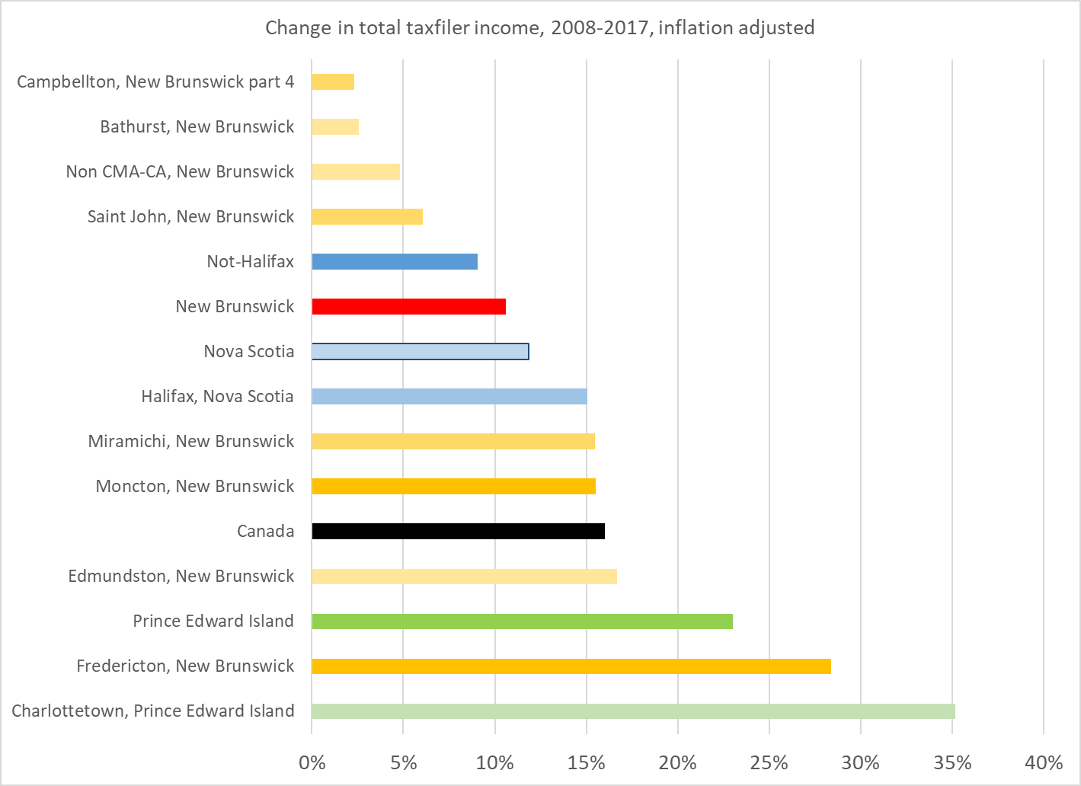
What’s the Challenge?
Many NB’ers are living in places that are growing…
Notes:
They are not aging at the same rate
They have the young people … who are still here
They are attracting immigrants
They are the happiest age groups with the way things are
those who don’t like it left…

Slide 13
Yogi Berra: ‘When you come to the fork in the road, take it!’

Slide 14
What is the opportunity?
Depends on what you believe makes you happy
BACK TO THE FUTURE
Build on traditional strengths
Address competitiveness challenges
Business sector driven,
less transfer dependent,
hinterland and city focused
STAY THE (NEW) COURSE
Use competitiveness challenges to transform the economy
Drive down traditional strength to create path for new industry to be named later
Public sector driven,
transfer dependent
city-focused,

