Slide 1
The Social Economy in NB
VIRTUAL CONFERENCE
Herb Emery, June 2020

Slide 2
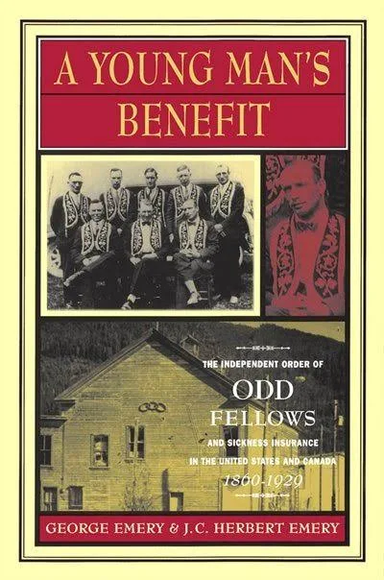
I am not an academic expert about the social economy but…
Studied history of voluntary sickness insurance and transition to government insurance
Worked with Immigrant Access Fund, Alberta Network for Immigrant Women to improve newcomer credential recognition
Worked with Sinneave Foundation and NBACL on policies to improve quality of life for Adults with neurodevelopmental disabilities
Worked on ROI measurement for difficult to monetize services with ARBI – not for profit working with severely brain injured
Worked on financial models and tax structures to address unmet health needs and for sustainable organization funding
I am on the Board of Science East and I participate in meetings and present to community groups

Slide 3
Challenge to define the Social Economy
Social economy can refer to:
Normative dimensions – social justice goals, democratic governance, autonomy from government
Practical dimensions – sources of funding, corporate structure (e.g. non-profit or volunteer based), autonomy
Residual part of economy not enumerated as government or commercial sector

Slide 4
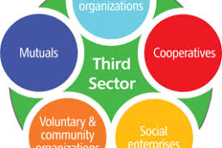
Social economy institutions
Often filling niches and gaps left by commercial sector and government
Affordable housing and access to food
Addressing services and activities difficult to monetize or not of sufficient public scale or priority for formal government program
SROI movement, public goods
Can be more ideally suited to private delivery but with challenges of being under-resourced
Immigrant Access Fund example
https://www.dianova.org/topics/types/social-economy-third-sector/

Slide 5
Gabriel Arsenault, Université de Moncton, is an academic expert on social economy
In NB, social enterprises are above all viewed as allies in the fight against poverty.
The 5-year plans for economic and social inclusion (e.g. Overcoming Poverty Together 3, 2020–2024) state this:
  “Make investments through a new social finance fund to increase the capacity and sustainability of social enterprises within non-profit organizations in New Brunswick.” (NB, 2020, p. 21)
Key initiatives: Social Enterprise Hub (Saint John); Community Accelerator, Hub Fund (Moncton).

Slide 6
Gabriel Arsenault:
The social economy at the federal level
Key plank in the Trudeau government platform (2018): An approximately $750 million Social Finance Fund in place by 2028 to assist social enterprises.
  If NB gets per capita share, $16 million available by 2028
    About 2% of current non-profit GDP in NB
      Not clear if that is total one time amount or an annual amount

Slide 7
Some statistics on the Social Economy… from what is available

Slide 8
Not for profits… 2% of GDP and 4% of employment
In Canada, GDP and employment in NFPs growing with the overall economy
IN NB they are not growing like the rest of the economy

Slide 9
Volunteering in NB
About 3.4% of provincial GDP
But not necessarily counted in GDP…
NB value of volunteering lags NS and AB

Slide 10
Some questions about the social economy
Is it the right size?
  Should more government responsibilities or business based services move to the social economy?
  Should more of social economy services be moved to government or business sector?
  Should we be using strategies like Basic Income and municipal zoning rules, to reduce need for services currently in the social sector?
Are the three sectors (government, business and social) doing the right things?
  Should government be doing the routine low cost things that business and social could do while leaving the complex, costly things to the social sector?
How do we create the sustainable, and predictable, resources for the social economy?
  Eg. Social impact bonds

